Slide 1
Getting Meta: A Multimodal Approach for Detecting Unsafe Conversations within Instagram Direct Messages of Youth.
By SHIZA ALI, AFSANEH RAZISEUNGHYUN KIM, ASHWAQ ALSOUBAI, CHEN LING, MUNMUN DE CHOUDHURY
Group no: 20
18101382 Protiva Das
22266005 Fairooz Afnad Faiza
22266004 Fatima Tabassum
22266006 Rafi Uddin Sadik
Submitted by:
PROTIVA DAS 18101382 ST : Md Farhadul Islam
RA: Md Humaion Kabir Mehedi

Slide 2
Introduction and Problem Statement
1.Social media platforms such as Instagram are increasingly popular among young people, but there is growing concern about the prevalence of unsafe conversations within Instagram Direct Messages.
2.The lack of effective tools for detecting unsafe conversations within Instagram Direct Messages can put young users at risk of experiencing harassment, bullying, or abuse.
3.The paper aims to develop a multimodal approach for detecting unsafe conversations within Instagram Direct Messages of youth.

Slide 3
Brief Background
1.The paper was published in the proceedings of the 2021 CHI Conference on Human Factors in Computing Systems.
2. The authors propose a novel approach that combines multiple modalities, including text, image, and metadata analysis, to detect potentially harmful content within Instagram Direct Messages.
3.The study involved collecting a dataset of Instagram direct messages and manually annotating them for different types of unsafe content, such as sexual solicitation, cyberbullying, and hate speech.
4.The authors argue that their approach can be integrated into Instagram's existing content moderation system to provide an additional layer of protection for young users.

Slide 4
Contribution
1.The paper proposes a novel multimodal approach for detecting potentially harmful content within Instagram Direct Messages of youth, combining text, image, and metadata analysis.
2.The proposed approach uses machine learning algorithms to analyze various features of the messages, such as sentiment, language style, and visual content, to identify unsafe conversations.
3.The study involved collecting a large dataset of Instagram direct messages and manually annotating them for different types of unsafe content, such as sexual solicitation, cyberbullying, and hate speech, which contributes to the development of a reliable and accurate model

Slide 5
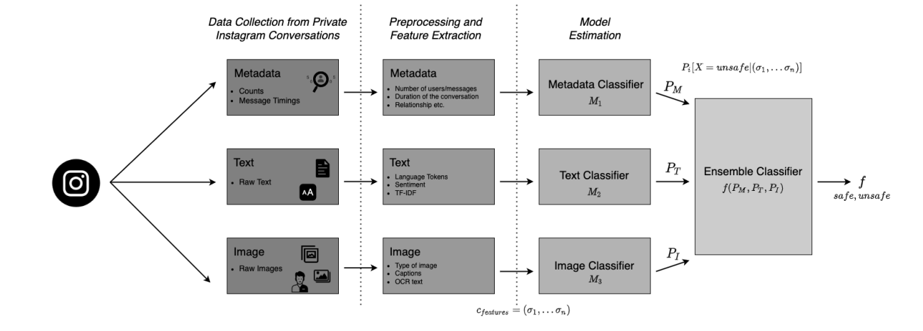
Methods
Characterizing Instagram Conversations
Metadata,Linguistic Cues,Image Features
2. Binary Classification: Detecting whether a conversation is safe or unsafe (RQ1) Majority-Vote Ensemble, Average-Vote Ensemble, Weighted-Vote Ensemble
3. Multi-Class Classification: Detecting the Major Risk Type of a Conversation (RQ2)

Slide 6
Results
The proposed multimodal approach achieved an accuracy of 85.1%, precision of 86.6%, recall of 84.3%, and F1 score of 85.4% in detecting unsafe conversations within Instagram Direct Messages.
The approach showed high precision scores for different types of unsafe content, such as sexual solicitation (94.2%), cyberbullying (76.8%), and hate speech (70.4%).
The proposed approach outperformed other existing methods for detecting unsafe conversations within social media platforms, demonstrating its effectiveness in improving the safety of social media users.
The study found that combining multiple modalities, such as text, image, and metadata analysis, improved the performance of the approach, with a 4.4% increase in accuracy compared to using only text analysis.

Slide 7
Analysis & Limitations
The research paper employs a novel approach for detecting unsafe conversations within Instagram direct messages of youth, combining both multimodal analysis and machine learning techniques.
The research paper focuses solely on Instagram direct messages, which may not capture the full range of unsafe conversations that occur on the platform.
The research paper only considers conversations in English, which may not be representative of the conversations that occur in other languages.
The research paper relies on a small sample size of conversations, which may limit the generalizability of the findings.

Slide 8
References
[1] Zainab Agha, Neeraj Chatlani, Afsaneh Razi, and Pamela Wisniewski. 2020. Towards conducting responsible research with teens and parentsregarding online risks. In Extended Abstracts of the 2020 CHI Conference on Human Factors in Computing Systems. 1–8.
[2] Shiza Ali, Afsaneh Razi, Seunghyun Kim, Ashwaq Alsoubai, Joshua Gracie, Munmun De Choudhury, Pamela J Wisniewski, and Gianluca Stringhini.
2022. Understanding the Digital Lives of Youth: Analyzing Media Shared within Safe Versus Unsafe Private Conversations on Instagram. (2022),1–14.
[3] Nasiru Ishola Aliyu, Abdulrahaman Musbau Dogo, Fatimah Olajumoke Ajibade, and Tosho Abdurauf. 2020. Analysis of cyber bullying on facebook using text mining. Journal of Applied Artificial Intelligence 1, 1 (2020), 1–12.

